Slide 1

SocialLyTiCs Project
Social media dashboard

Slide 2

Content
• User Authentication
• Tools and Technologies
• Account Integration
• Data Visualization
• Analytics & Insights
• Post Scheduling & Management
• Conclusion

Slide 3
Tools and Technologies
Frontend:-
HTML , CSS , BootStrap , JavaScript , React
Data Visualization Libraries:-
ChartJS

Slide 4
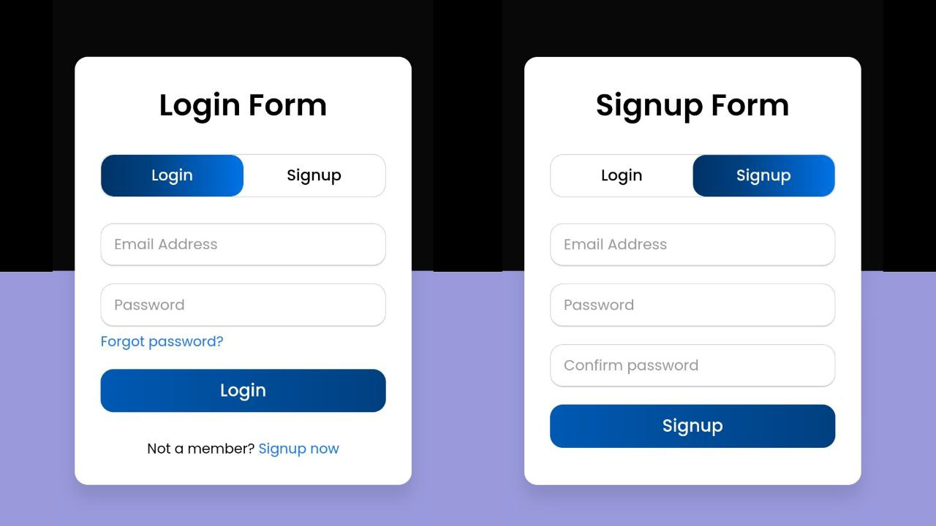
User Authentication
Secure login functionality integrating with social media platforms for easy login
User profiles with preferences and settings .

Slide 5
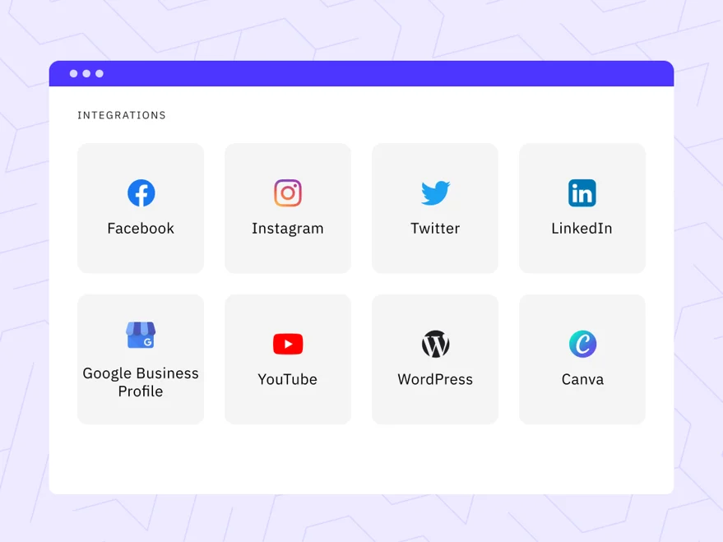
Account Integration
Ability to link multiple social media accounts (e.g., Instagram, Twitter, Facebook) to the dashboard.

Slide 6
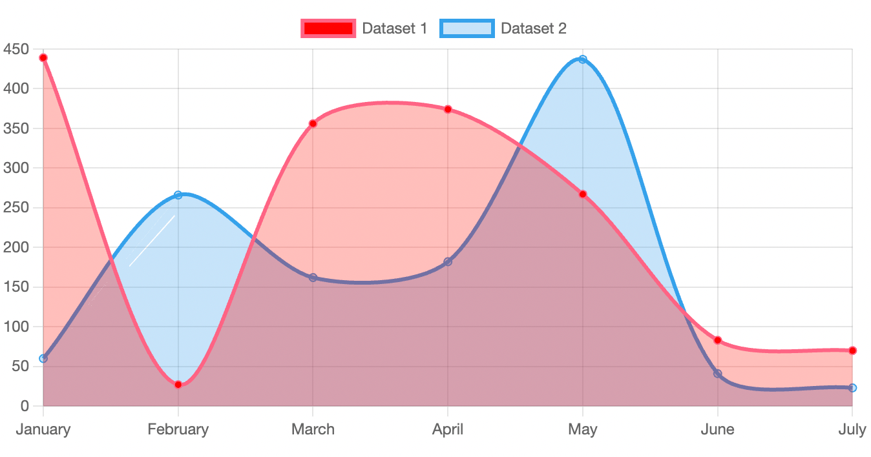
Data Visualization
Interactive charts, graphs, and tables
to visualize performance data
Time series data analysis to show trends over time.
Display of key metrics like followers, engagement rates, post interactions (likes, comments, shares), impressions, and reach.

Slide 7
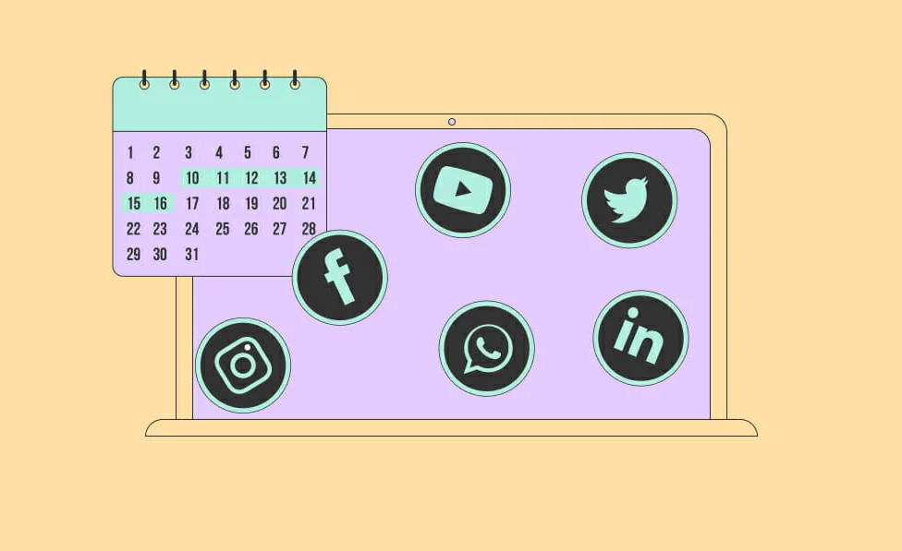
Post Scheduling & Management
• Feature to schedule posts across multiple platforms.
• Calendar view for scheduling and managing content.
• Calendar view for scheduling and managing content.
• Drafting and editing posts with preview functionality.

Slide 8
Conclusion
Businesses: To track their social media campaigns, brand awareness, and online reputation.
Influencers: To analyze engagement and growth across different platforms
Marketers: To monitor the effectiveness of their content strategy and adjust as needed.
Agencies: To manage multiple clients’ social media accounts from one centralized dashboard.

